Slide 1

School Mission Statement

Slide 2
End of Year 2 results 2024:
Children reaching the expected level in Reading: 86%
Children working above the expected level in Reading 32%
End of Year 6 results 2024:
Children reaching the expected level in Reading 91%
Children working above the expected level in Reading: 42%

Slide 3
How do we teach reading at Cheadle Catholic Infant School?
It is crucial for children to develop a life-long love of reading.
Reading consists of two dimensions:
Language comprehension
Word reading
Language comprehension (necessary for both reading and writing) starts from birth. It only develops when adults talk with children about the world around them and the books (stories and non-fiction) they read with them, and enjoy rhymes, poems and songs together.
Skilled word reading, taught later, involves both the speedy working out of the pronunciation of unfamiliar printed words (decoding) and the speedy recognition of familiar printed words.
How do we do this?
Language comprehension is taught through shared and guided reading every day.
Word reading is taught through phonics.

Slide 4
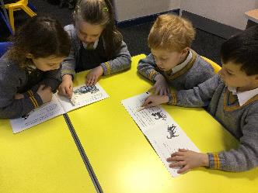
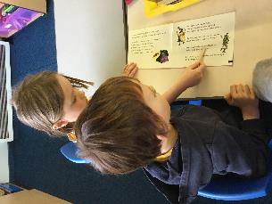
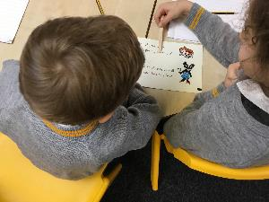
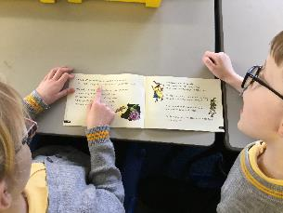
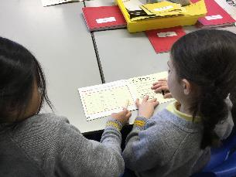
Language Comprehension

Slide 5
Phonics at CCIS
We use Read Write Inc (RWI) as our phonics program.
This is a sequenced and structured synthetic approach to teaching phonics, with writing aspects included.

Slide 6
Why Read Write Inc Phonics?
Tried and tested over many years
Systematic and structured
Early success in reading
Training and ongoing staff development
https://www.youtube.com/watch?v=MbWIujM1WGM

Slide 7
How does it work?
Children:
Learn 44 sounds and matching letters/letter groups
Learn to blend sounds to read words
Read lots of specially written books
Learning to identify sounds (phonemes) and blend them together is called decoding.

Slide 8
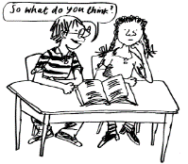
How does it work?
Children:
Talk a lot about what they have read to show they understand
Listen to and discuss other ideas to deepen understanding
This is comprehending
We do lots of talking in partners

Slide 9
Sounds
All words are made up of sounds
In English there are 44
Sound Pronunciation Guide
https://www.youtube.com/watch?v=KUbrJPAt65g

Slide 10
Graphemes
A grapheme is a sound written down
English has more than 150 graphemes
There are more than 150 ways to represent the 44 sounds using our 26 alphabet letters
A complex code!
You

Slide 11
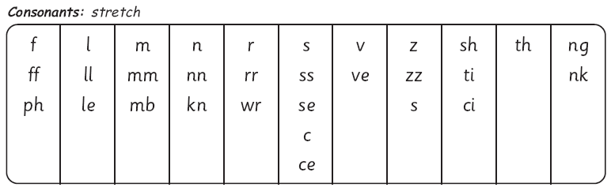
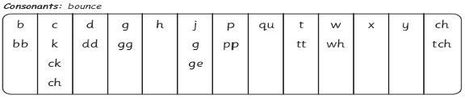
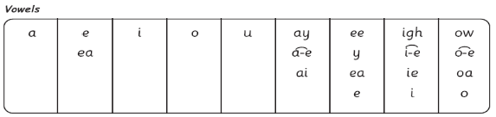
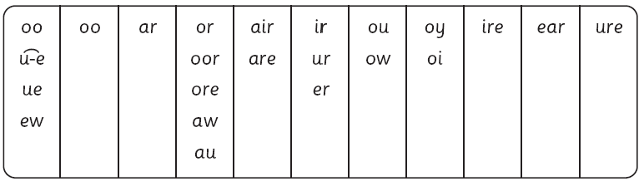
The complex English alphabetic code

Slide 12
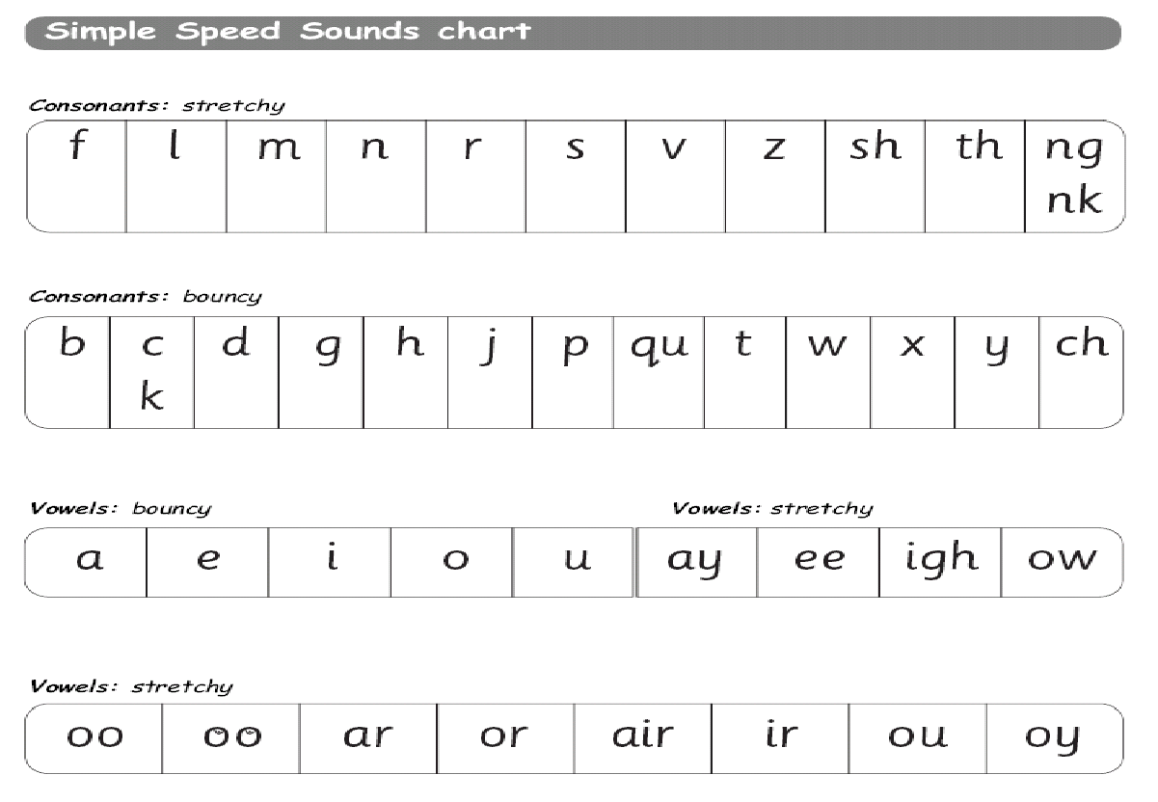
Learning the code
Children learn a simple code first
Notes:
12

Slide 13

Fred...
Fred helps children learn to read
Fred can only talk in sounds...
(Fred can only say c_a_t, he can’t say cat)
We call this Fred Talk

Slide 14
Fred…
If children understand Fred they can blend orally
Blending is needed for reading

Slide 15
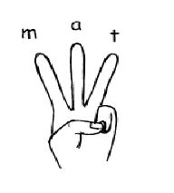
Fred...
Fred helps children learn to spell as well!
Children convert words into sounds
They press the sounds they hear on to their
fingers...
We call this Fred Fingers

Slide 16
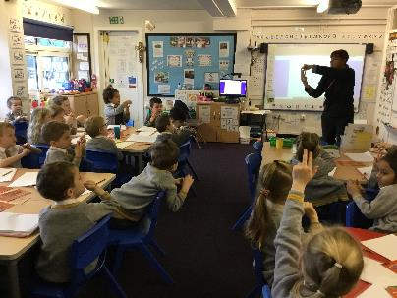
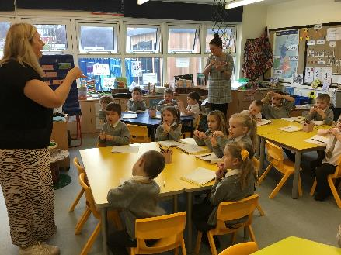
Fred Fingers

Slide 17
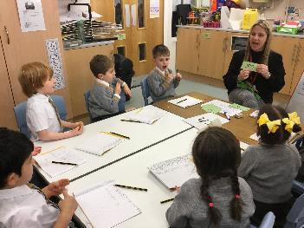
Green words
Green words are words we can Fred talk. Words we can segment and blend.
For example – play and coin

Slide 18
Red Words
These were called tricky words.
Red words are words we can’t Fred talk.
For example the said
You can’t Fred a red!

Slide 19
Consonants: stretchy
f | l | m | n | r | s | v | z | sh | th | ng
 |  |  |  |  |  |  |  |  |  | nk
Consonants: bouncy
b | c | d | g | h | j | p | qu | t | w | x | y | ch
 | k
Vowels: bouncy
Vowels: stretchy
a | e | i | o | u | ay | ee | igh | ow
oo | oo | ar | or | air | ir | ou | oy
Set 1 sounds
Set 2 sounds

Slide 20
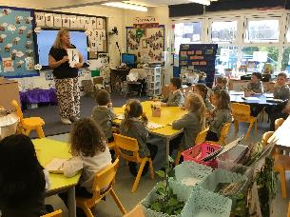
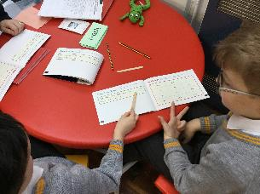
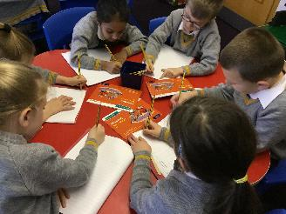
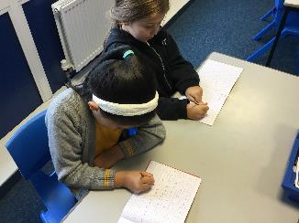
Phonic teaching at Cheadle Catholic Infant School

Slide 21
Organisation - Reception
During the Autumn term, the children are assessed and put into groups.
They learn to say, read and write each sound.
Within a small focus group in the classroom with the teacher/TA, each day the children are learning skills to support them with their reading.
Focused teaching using the storybooks alongside the phonics will enable children to read with increasing accuracy and fluency.
When the children can read fluently they are much better equipped to understand the text.

Slide 22
Year 1 and Year 2
Children continue learning phonics in the same way as they move into Year 1. They are assessed a minimum of half termly and grouped based on their phonic knowledge and supported to continue to develop their phonic skills in readiness for taking the phonics screening check in June. Any children who require additional support in Year 1 will have a period of 1:1 phonics tuition.
Most children will have completed the RWI phonics programme by Christmas in Year 2. Children who would still benefit from phonics teaching in Year 2 will continue with the programme.

Slide 23
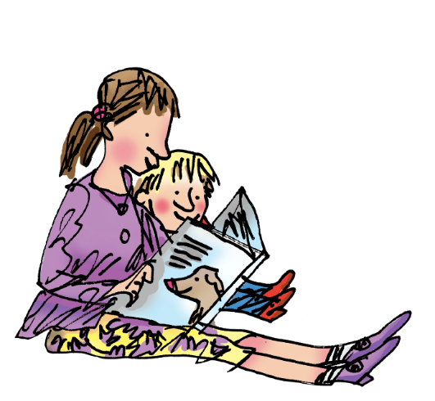
How to help your child at home…

Slide 24
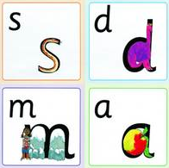
You can practice pronouncing sounds.
Remember no ‘fuh’ and ‘luh’!

Slide 25

Reading books home
Books will be sent home to be shared with your child.
These are called ‘Book Bag Books’. They will match the sounds your child would be learning in the classroom.

Slide 26
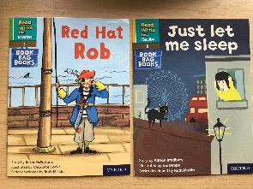
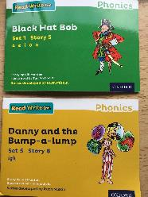
Your child should be able to read their book bag book with confidence because they have practised many of the words in school. Reading the book bag book at least 3 times will build their fluency and confidence. This will help them gain a pride in their ability. It will also give you opportunities to ask questions and improve their comprehension skills.
Books sent home are not meant to be too challenging to read.
We want your child to love reading and to become confident in their ability.
Give your child lots of praise and tell them that they are amazing!!
The challenge will happen in school.

Slide 27
And...
By having fun with Fred Talk at home!
“Where’s your c-oa-t?”
“Time for b-e-d!”

Slide 28
And...
By reading to your child lots of lovely stories and asking lots of questions!
Use these prompts to help you:
What is that character thinking?
What is happening?
What do you think
happens next?
What is the character saying?
What do you
think that character is
feeling now?

Slide 29
We want your child to love reading – and to want to read for themselves. This is why we put our efforts into making sure they develop a love of books as well as simply learning to read.

Slide 30


Slide 31
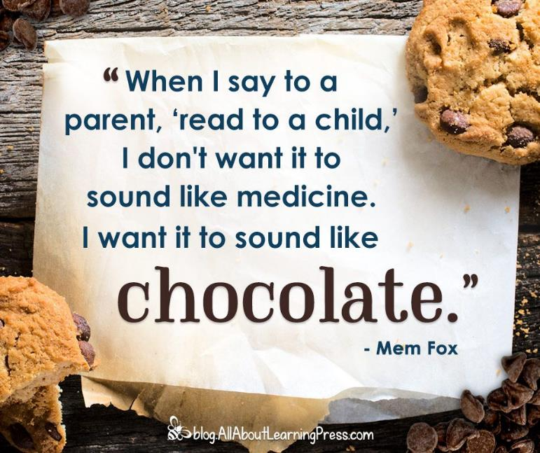

Slide 32
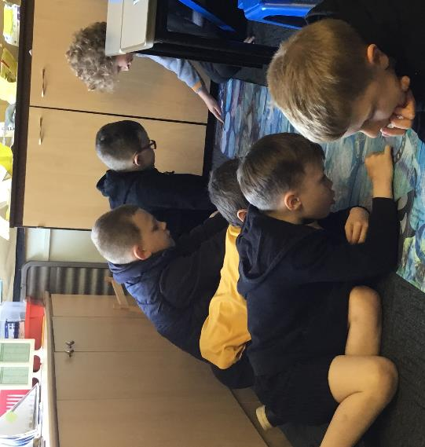
Reading together helps to make reading a sociable event rather than a solitary pastime.

Slide 33
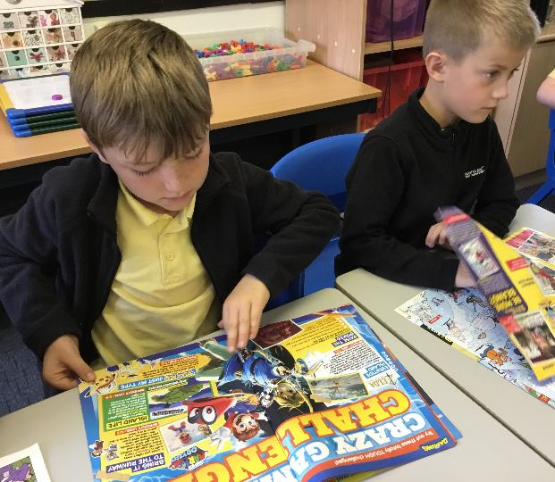
All reading is good reading
Magazines
Comics
Graphic novels
Picture books
Board books
Audio books

Slide 34
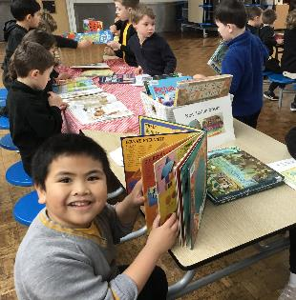
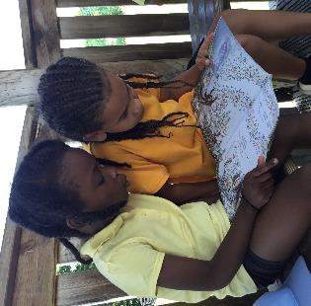
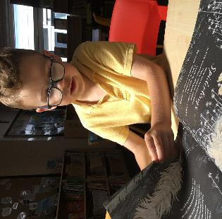
Give them the tools, the time and the space so that with your help they can discover the joy of reading.

Slide 35
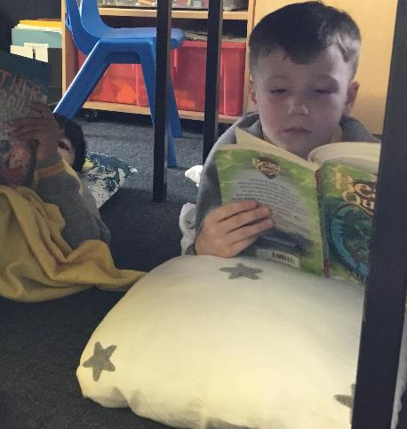
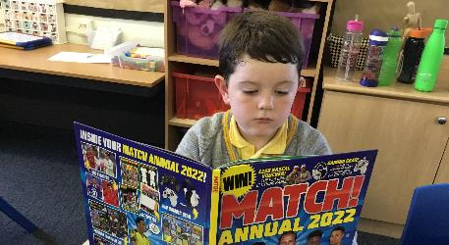
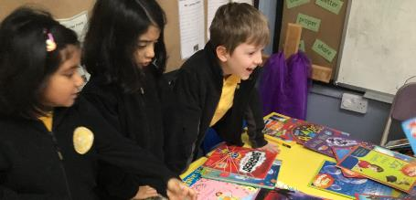

Slide 36
And…
Please don’t forget to read to your child!
This is a vital part of learning to read!
Your child will experience the pleasure of reading and sharing stories and this will encourage them on their own reading journey.

Slide 37

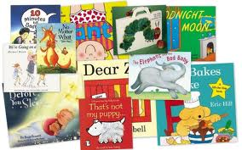
Thank you...
Happy reading!

