Slide 1

How can we make geography and history accessible to children with SEND at our school?
How can we make sure everyone reaches their full potential?
Claire Nelson and Ellie Ward
Cheadle Catholic Infant School

Slide 2
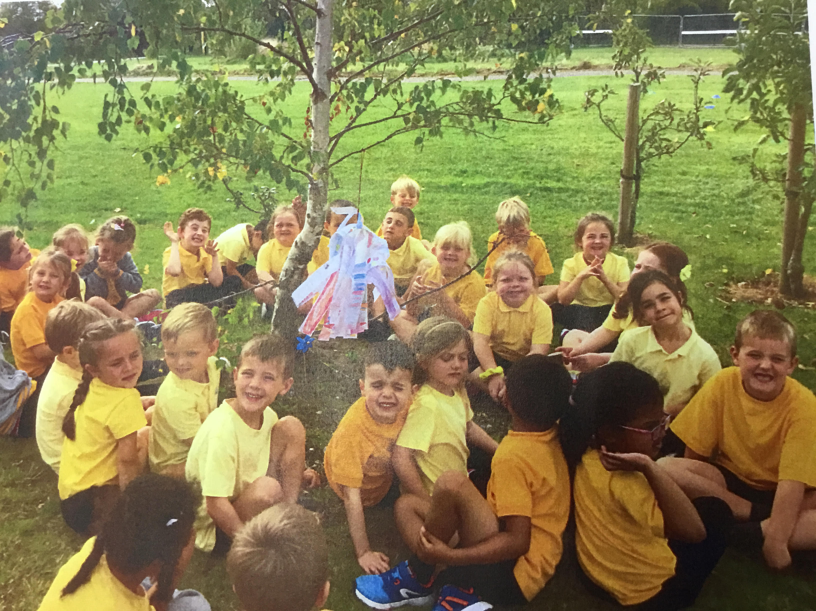
Approximately 7% of children at Cheadle Catholic Infant School have been identified as having Special Educational Needs and/or Disabilities. We understand that within this group, the strengths and requirements of the children vary greatly but we know that in general terms there are barriers which prevent them from achieving in line with end of Key Stage expectations in History and Geography. As a result, we have created this reflective document to help us consider the best ways to help them learn and retain key concepts, knowledge and vocabulary. In this way we will ensure that all children are engaged in their learning and given the best possible chance to achieve their potential.

Slide 3
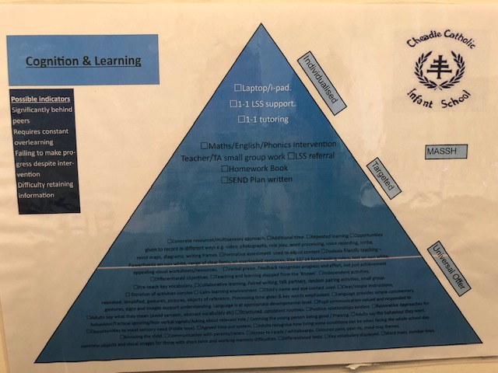
Cognition and Learning:
The Universal Offer
The starting point for our reflections was to look at the ‘Cognition and Learning’ strand of the Universal Offer and select core strategies that would underpin our lessons and permeate our Schemes of Work so that everyone could access the curriculum.

Slide 4
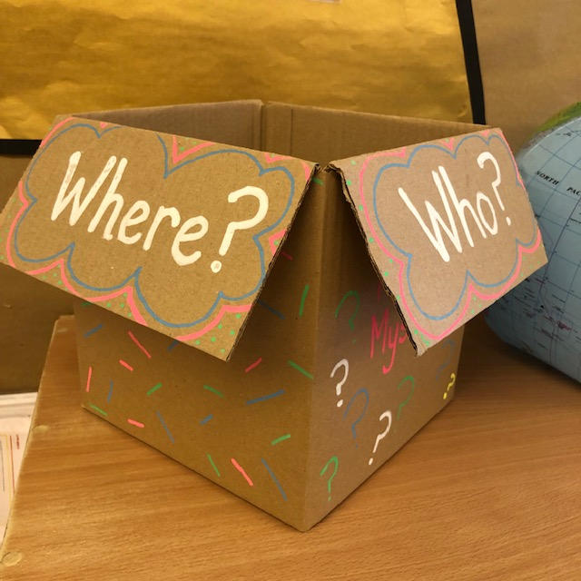
Strategy 1:
Repeated Learning
All children benefit from the opportunities to repeat and revisit both knowledge and skills that they learn in History and Geography lessons and this is even more important for children with SEND. Our schemes of work have been designed to overlap so that children are constantly revisiting work from previous years. We also make sure that children have opportunities to think back and make links between topics, creating hooks that new learning can build on. We know that ‘forgetting’ is a natural part of how our memories work and so we build in short activities to recall key facts, interrupting the ‘forgetting’ process and giving children the best possible chance to get their learning to stick.
History Mystery Box
The history mystery box is a key tool in recalling facts. Each time a significant person, place or event is studied a picture is put into the box. Every history lesson begins with an activity related to something from the box so the children can revisit prior learning and make connections between previous topics and new learning. As the result of success with the ‘History Mystery Box’ we are implementing a similar strategy in Geography this academic year.

Slide 5
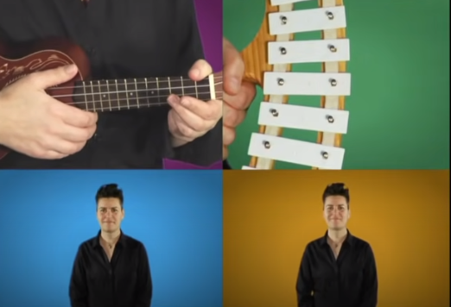
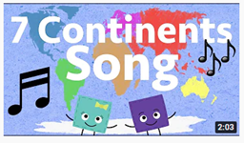
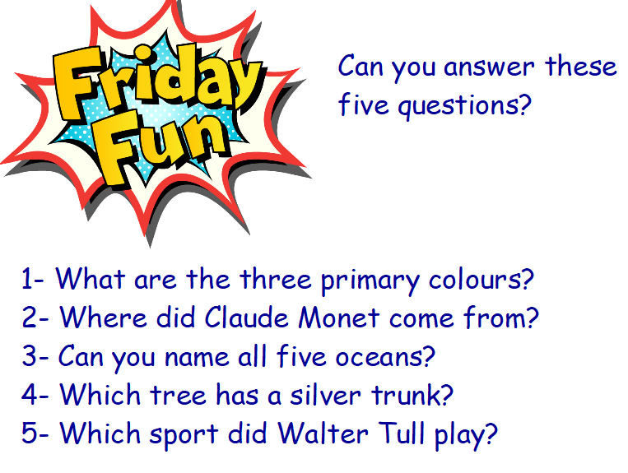
Quizzing
History and geography lessons always begin with a short recap activity. It could be ‘Pin the Continents on the Map’ or a game of ‘Who am I?’ about a significant person. Children usually work with a talk partner for these activities so that all children are engaged and ready to respond if their name is picked to answer the question. As well as strengthening recall skills, we have found that this boosts confidence as children start the lesson with something they know.
Songs and Rhymes
With an emphasis on retaining and recalling key facts on the KS1 history curriculum, we have found that songs and rhymes create a hook that helps children to remember. Singing and signing along also helps children to use audio and kinaesthetic learning styles and gets a very positive response from the children. If a child is struggling to recall a fact, teachers can prompt a child by saying ‘remember what we learnt in the song’ which is just enough to help a child recall the correct answer independently.

Slide 6
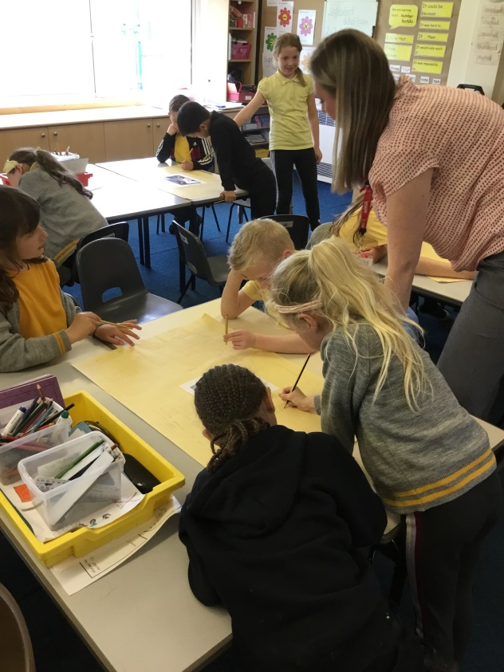
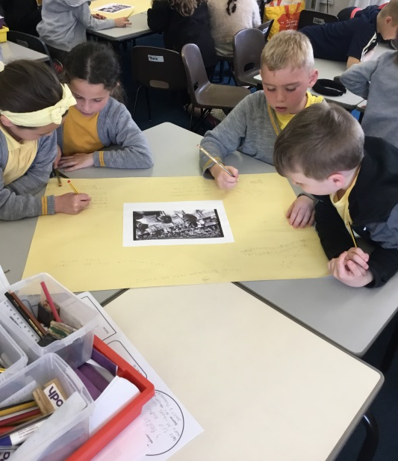
Strategy 2: Collaborative Learning
Collaborative learning is the second key strategy we have identified because we understand the importance of children talking to their peers, learning alongside their friends, working as a team and not becoming over-reliant and/or led by adults working in the class. We acknowledge that some children need one-to-one support to communicate or adults to help navigate working with others but where possible we want to create chances for children with SEND to discover, explore and learn alongside everyone else.
Groupwork
Opportunities for group work are regular features of geography and history teaching in our school. In this photograph, the children are working on a collaborative groupwork technique called a ‘flat chat’. The children in this group are a mixture of abilities and the prompt for the discussion is a photograph which ensures that everyone can get involved straight away. The children follow the enquiry triangle structure so that they have a familiar format to rely on. They respond to each others’ comments and discuss ideas. Children with SEND participate successfully because adults are there to help scribe or spell and to read other children’s writing aloud but the emphasis is on all children working together.

Slide 7
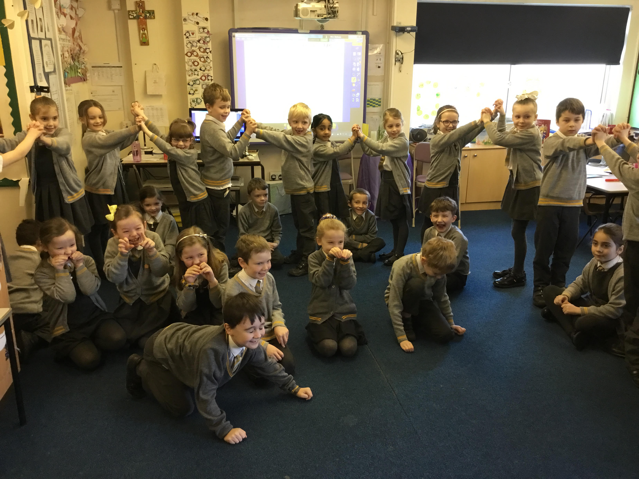
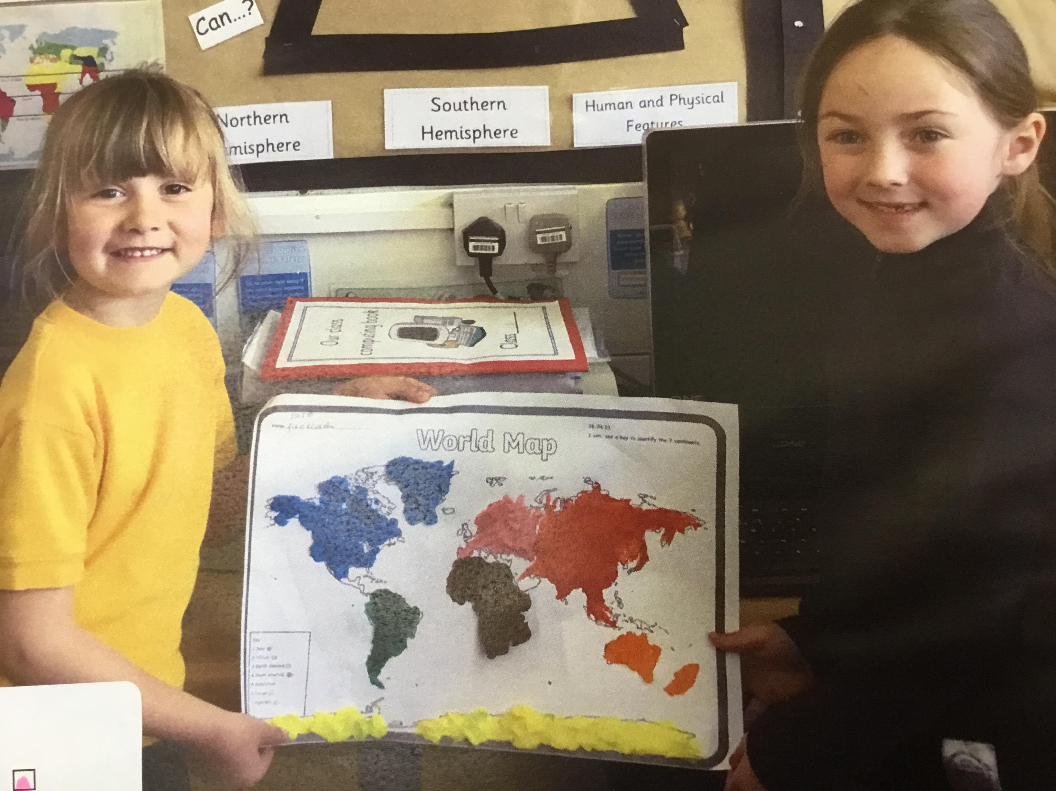
Paired Work
Talked partners are probably our most utilised collaborative learning strategy. Children with SEND are supported to join in with these parts of the lesson through
Being paired with different children throughout the year.
Having an adult nearby to prompt or question if the discussion goes off task or the ideas dry up.
Having a physical object or picture prompt so that the conversation does not rely on purely abstract ideas.
Fostering these skills from the very beginning of school life using resources such as the curiosity cube.
Whole class collaboration
There are sometimes opportunities for the whole class to work together as a team as they learn. These often involve DEAL techniques which are an excellent way to get everybody engaged in the lesson. However, to make sure all children can participate fully, including those with SEND, it is important to use techniques such as ‘magic microphone’ to make sure the children are following the lesson and not copying what others are doing.

Slide 8
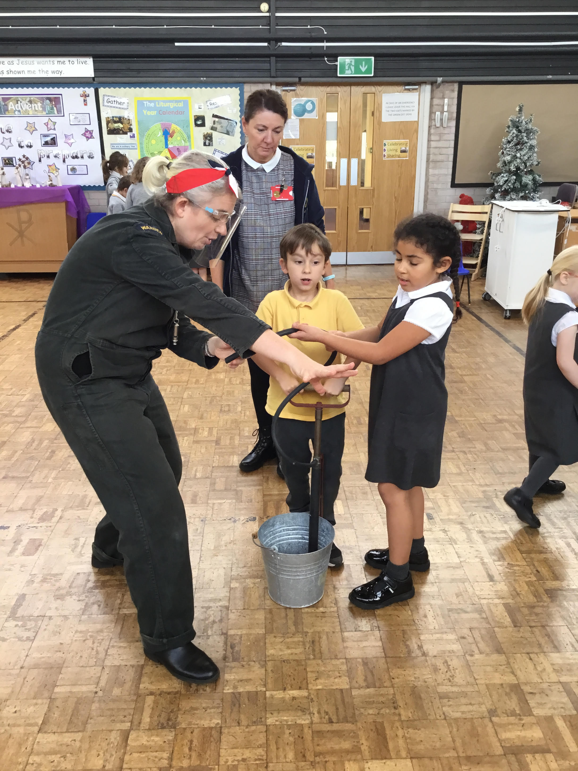
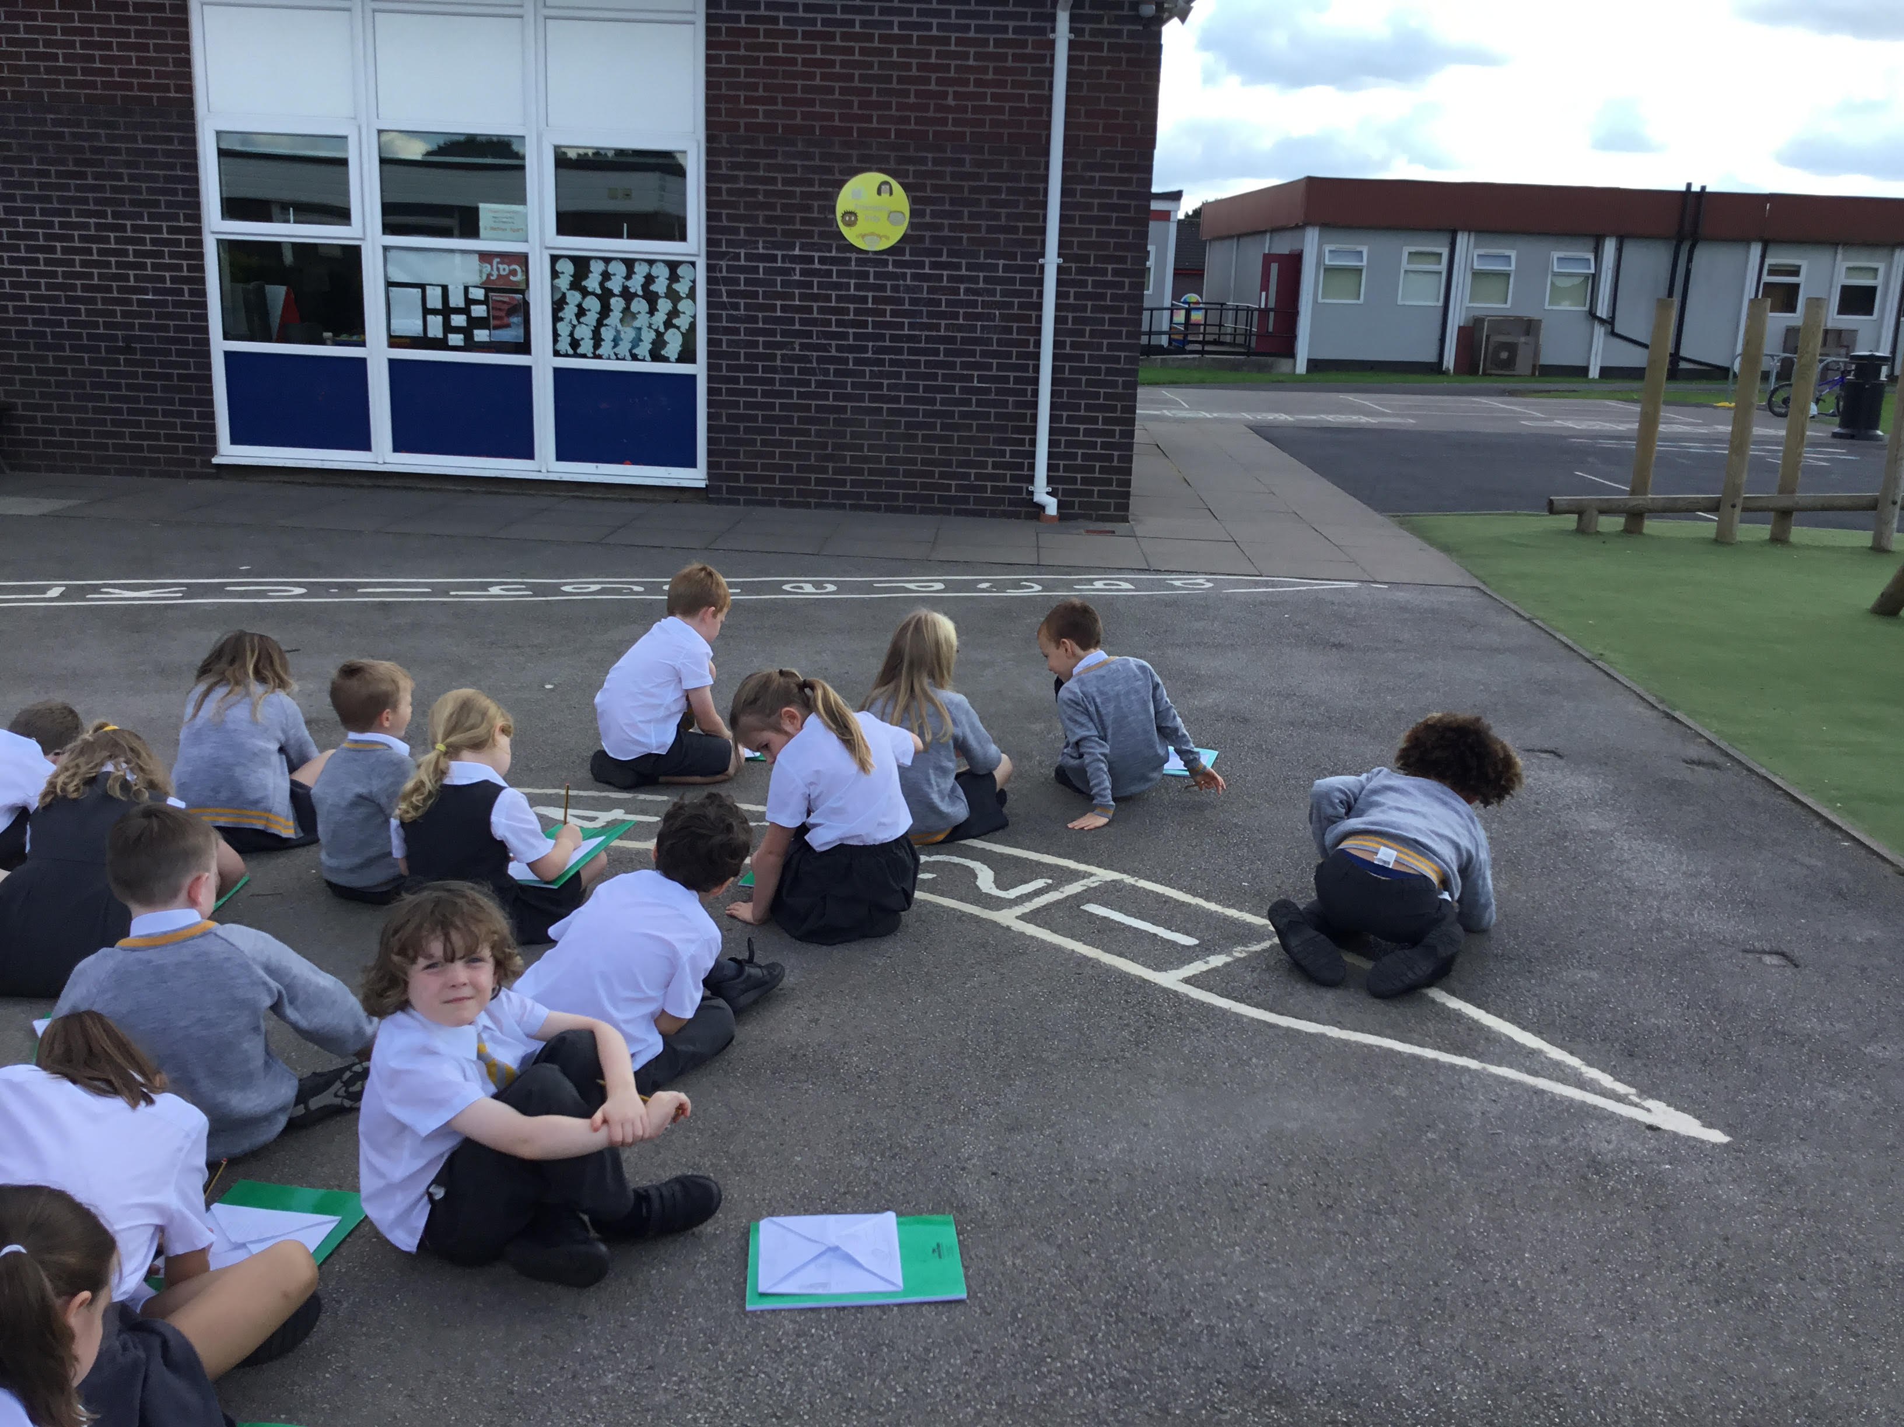
Strategy 3:
Duration of activity
Children with SEND, like most young children, benefit from a series of short, concise activities within a lesson as this is less taxing to the working memory (fewer instructions to remember in one go are easier to follow) and allows children to focus on the learning. It also means that new information can be presented in small chunks, which when linked to prior learning reduces the mental load and gives it a better chance at going into the long term memory. So when children have the opportunity to learn in this way they are more likely to be successful. This is not only good for a child’s learning but also for their confidence and self-esteem as they see themselves doing well and this creates a positive attitude towards themselves and their work. History and Geography lessons in KS1 at Cheadle Catholic Infant School follow this structure to give everyone the best chance to thrive.

Slide 9
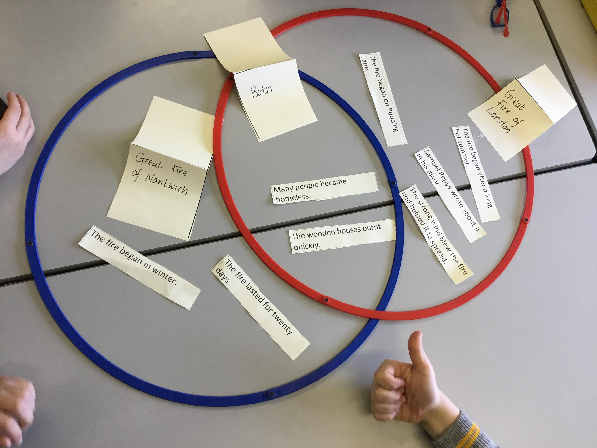
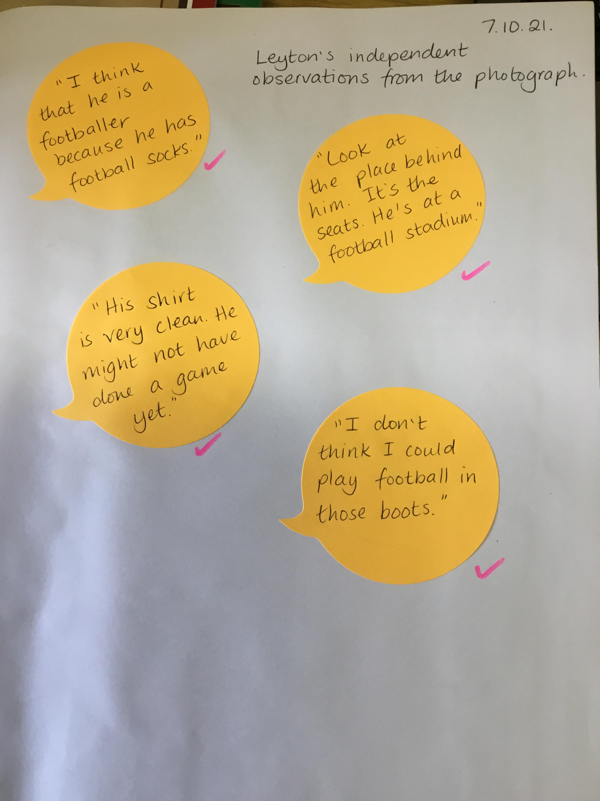
Strategy 4:
Recording in different ways
As teachers, we are very conscious that sometimes what a child is able to record is not necessarily a true reflection of what they understand, especially in the case of children with SEND. That is why we make sure that children are given many varieties of ways to record so that the work in their books truly shows what they know. This may take the form of photographs, pictures with scribed sentences, post-it notes of things they have said during an activity that have been written down by an adult, short videos, collaborative writing, use of IT equipment or independent writing.

Slide 10
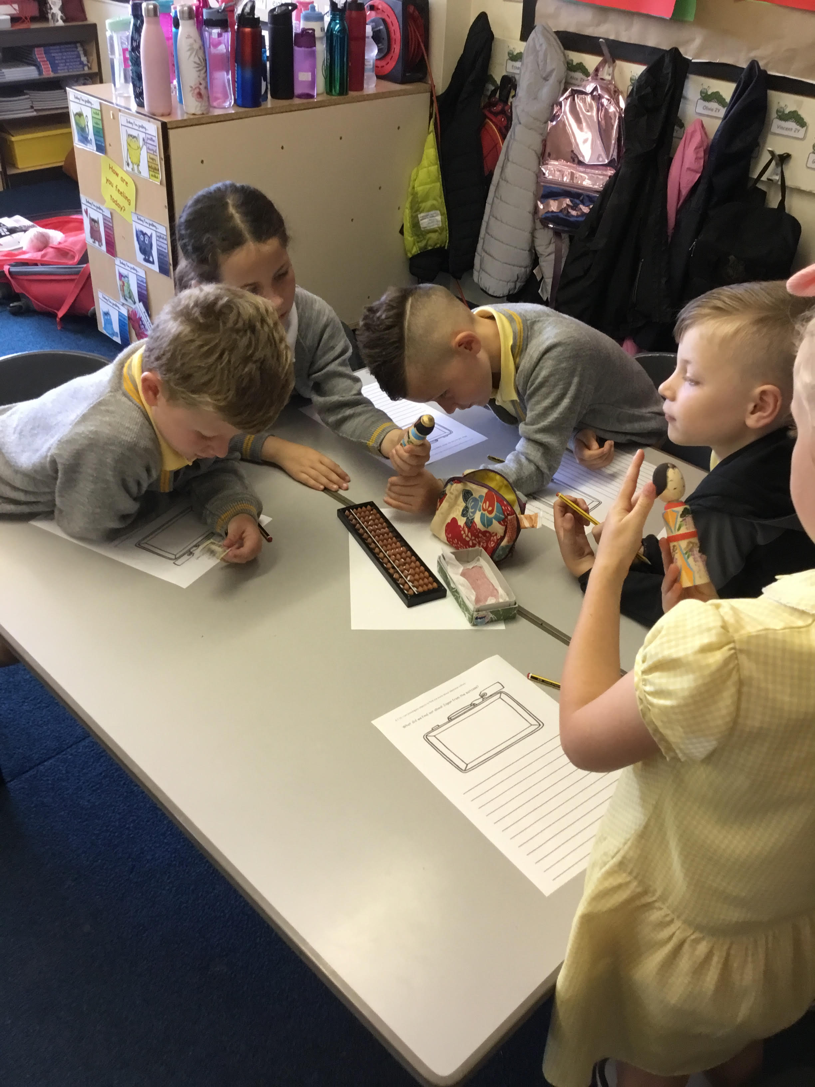
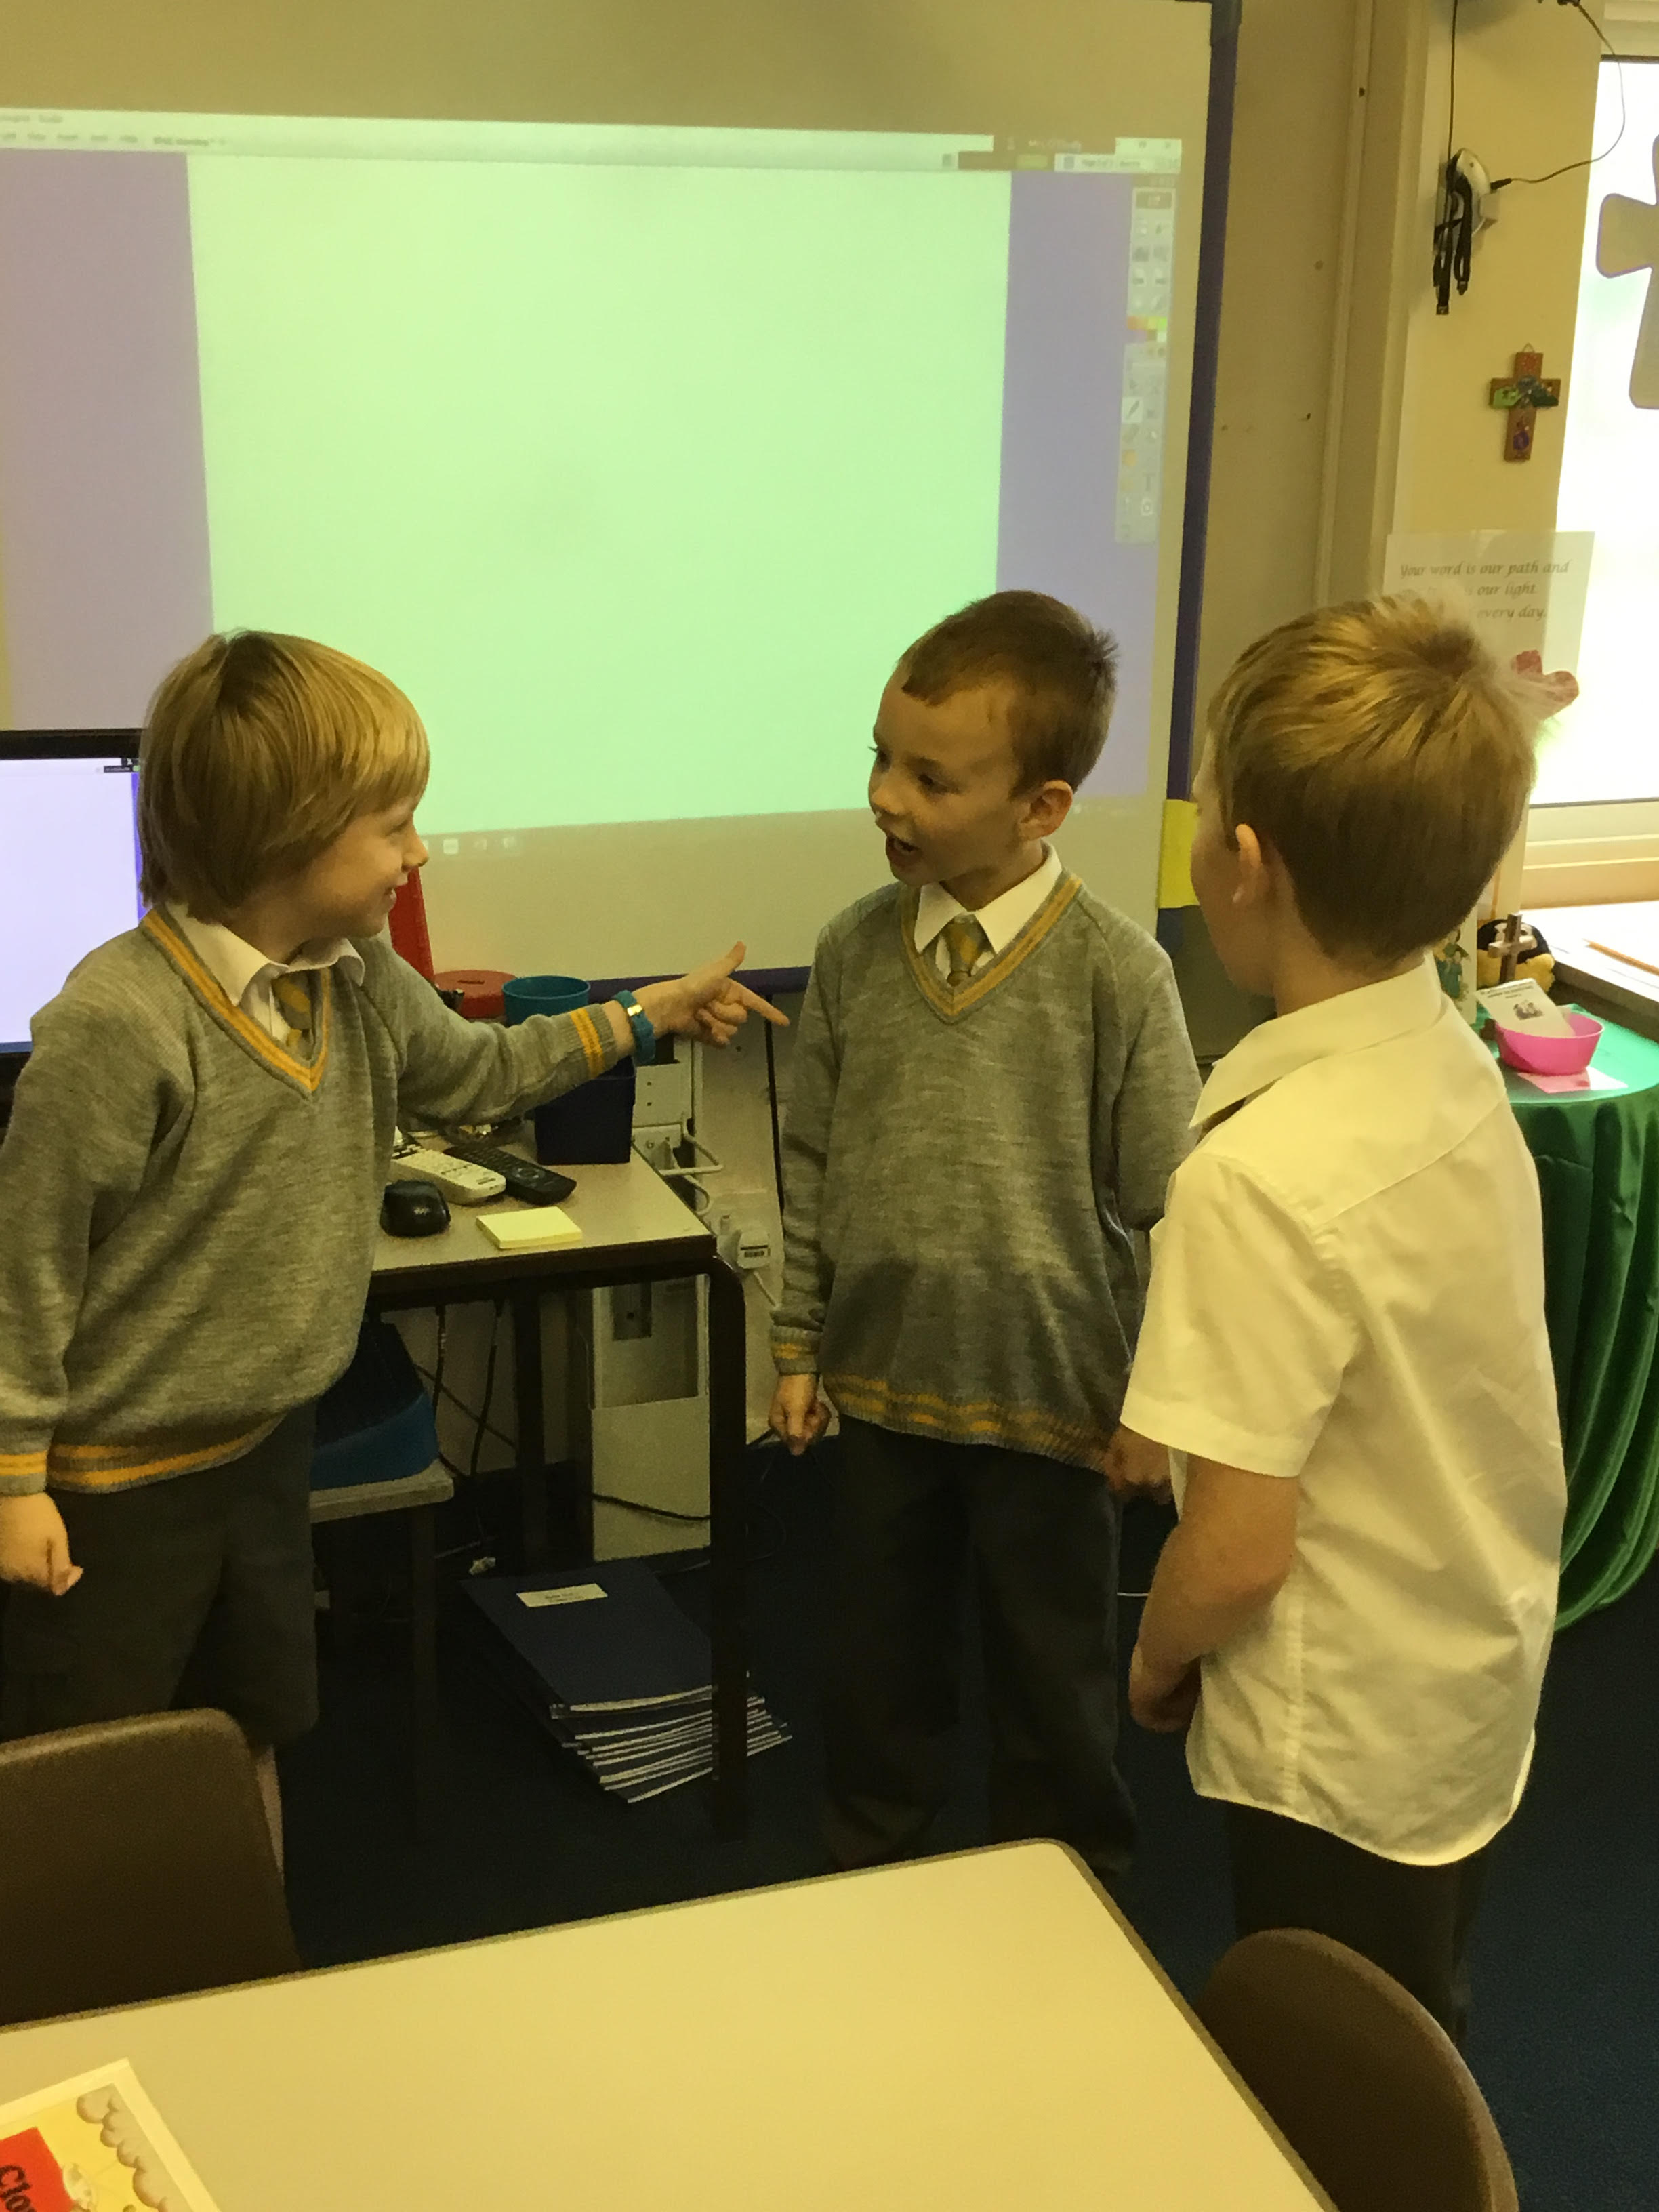
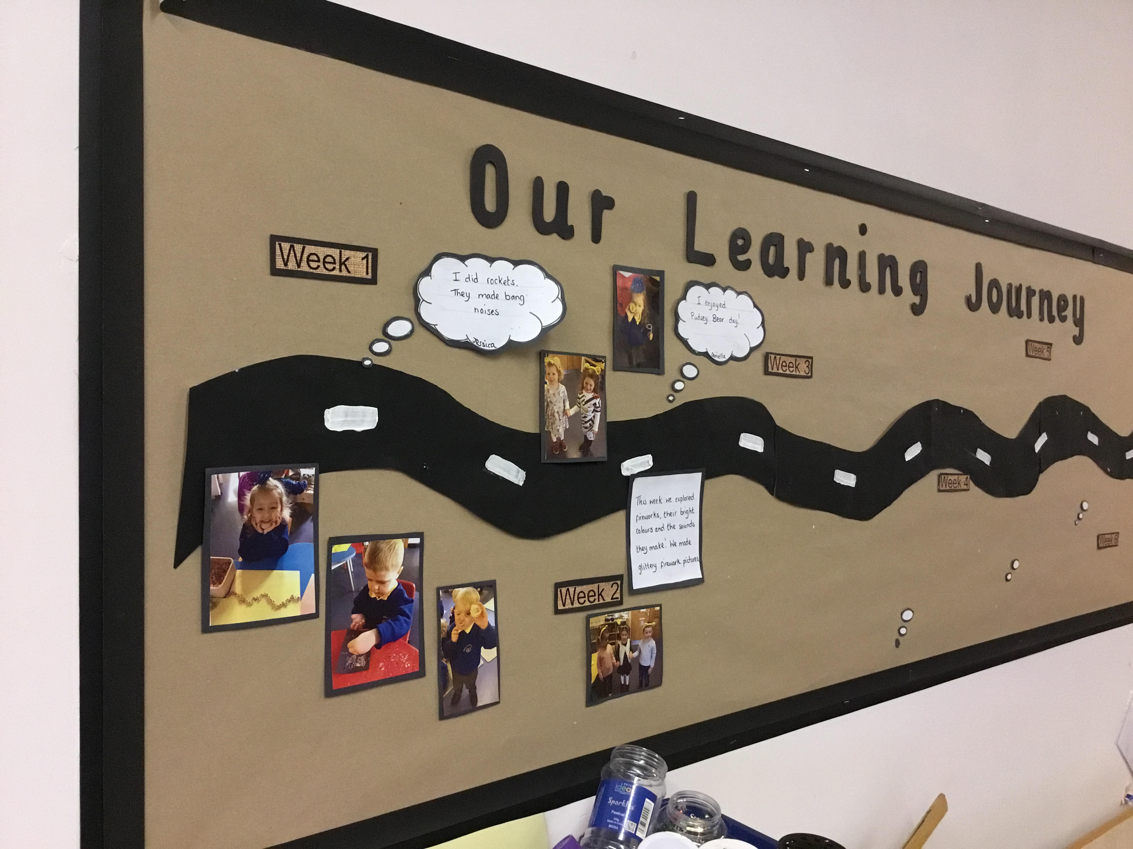
Our aim in this reflection is to find a way of making sure that History and Geography are accessible to every child. While it will not be practical to implement all of these strategies in every lesson, every lesson will be expected to contain some of them. These core strategies, alongside our high expectations, mean that children with SEND are able to enjoy and achieve in these areas of the curriculum. Their progress will now be monitored closely to see what impact this has on attainment and will be adapted in the future as needed.
Claire Nelson and Ellie Ward
Cheadle Catholic Infant School

