Slide 1
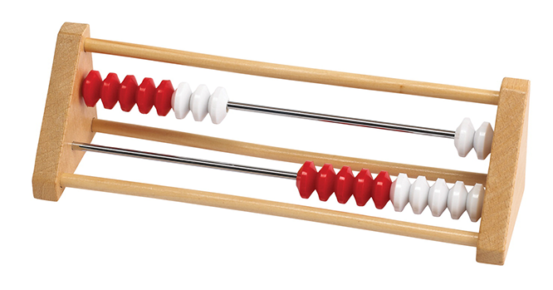
Mastering Number Programme

Slide 2
Overview of the programme
The programme is for 4-7 year olds.
Whole class teaching 4 days of the week.
10-15 minutes extra maths session (number sense)
The aim is to strengthen the understanding of number and fluency with number facts.
A lead teacher from Reception , Year 1 and Year 2 receive training and resources equipping them to give their daily short ‘number sense’ session. The lead teachers support the other teachers in their year group.

Slide 3
The materials include teachers notes, teacher slides and teacher resources.
Central training – on line 3 sessions in the year .
In the year programme the children use a range of materials and representations
Lead teachers are encouraged to engage in an on line platform which is led by a maths specialist (localised work group )
The use of a rekenrek is one element of the Mastering Number Programme. It develops confidence and fluency.

Slide 4
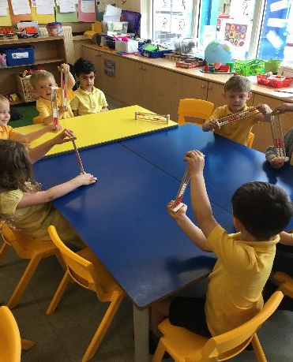
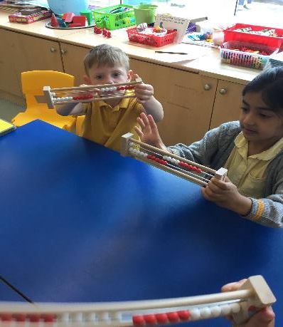
A week of Mastery at Cheadle Catholic Infant School.
Reception : The introduction of the Rekenrek , learning to
show amounts using 1 push (subitise to 5 )

Slide 5
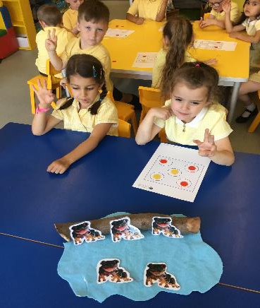
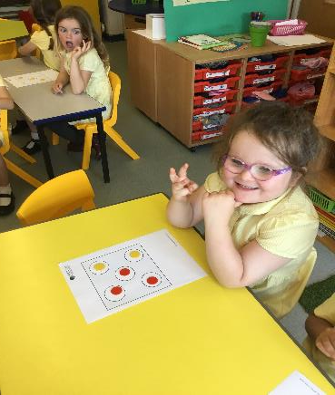
Reception Automatically recall number bonds to 5.
“ I know that 2 and 3 makes 5. “ 3 red to show the frogs on the log
If 3 frogs are on the log 2 are in the pond” and 2 yellow to show the frogs in the pond”
Stem sentence “ 5 is made of 2 and 3.”

Slide 6
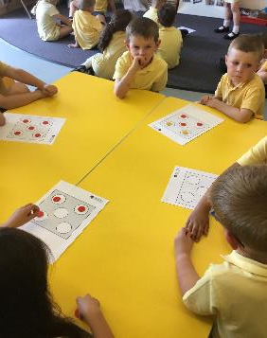
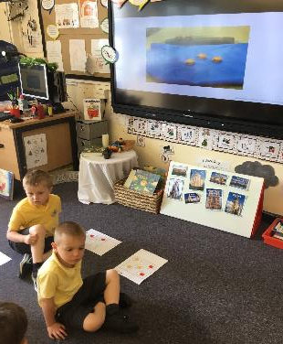
Reception
Exploring 5 with the song/slides.
5 speckled frogs .

Slide 7
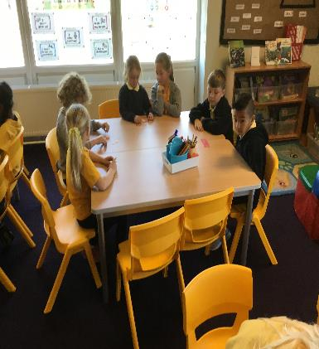
Year 1 Counters – making equal groups.
“ Moving counters help me to
solve problems”
“ Working with a talk partner means I have someone to help me”

Slide 8
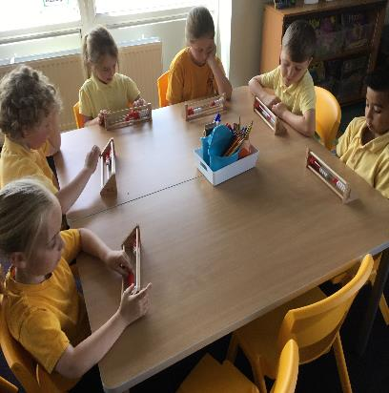
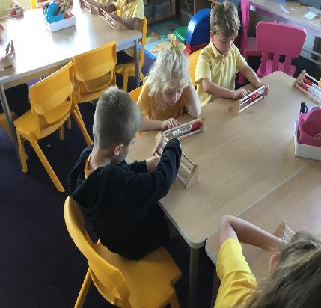
Year 1 Rekenrek – exploring odd and even
“ They help us count and show “ They help when I am counting in 2’s”
amounts.” “ They are good to show odd and even”

Slide 9
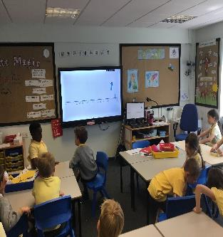
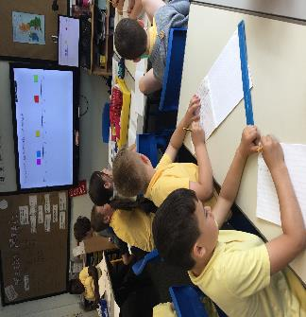
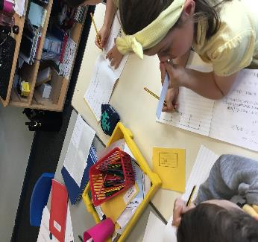
Year 2: Multiplies of 5 sit half way between multiples of 10
“45 is between 40 and
50”
“ I know that 21 comes straight after 20 on the number line because 21 is 1 greater than 20”
“I know that 20 comes before 25 because 20 is 5 less than 25. I counted in multiples of 5”

Slide 10
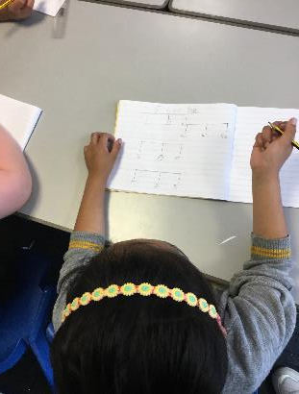
Year 2
Multiplies of 5 sit half way between multiples of 10.

Slide 11
Impact at Cheadle Catholic Infant School
Reception
Repetition allows for a greater understanding and a strong number
sense .
Children are fluent with their number facts (stays in their memory).
Excellent use of concrete to pictorial to abstract.
We don’t have different ability groups anymore.
Subitizing to 5 is amazing. “see the amount don’t count”
The children keep up not catch up.
Most of the new curriculum is covered in the Mastery programme.

Slide 12
Year 1
Mastery maths has opened up a whole new kinaesthetic approach to
partitioning, doubles and place value .
The Rekenrek is another manipulative to support partitioning.
Subitizing – 1 amount, 1 push
Repetition of stem sentences and has increased knowledge and fluency of number facts.
It has helped to close the gaps from Reception, but not completely.

Slide 13
Year 2
An invaluable tool to assist with the start of the lesson. It is fully inclusive.
Mastery maths has been an essential part of filling the gaps the children had after two years of disruption. It enabled children of all abilities to get back to basics and revisit the core building blocks needed to fully access the Year 2 curriculum. The mixture of repetition , visual cues and manipulatives seem to appeal to the whole class and help the learning ‘stick’ . Not only do they now recall key facts quickly and fluently but it has given the children the tools to describe and explain how they reach their answers which is such an important step in their learning.
This year all children stay in whole maths lesson the whole time (no interventions groups).
It has helped with the SATs, the children are using their mental strategies and applying this to greater depth problems.
After moderation we now know we have more children working at GD in maths.

