Slide 1
Cheadle Catholic Infants
Welcome to our Workout wheel.
Have fun being active!
The Wheel (BBC One) Main Theme by Paul Farrer - YouTube

Slide 2
Early years..
1. Jump on the spot | 9. Shrug shoulders | 17. Skaters
2. Touch your right knee | 10. Hip circles | 18. Right ankle circles
3. Touch your left knee | 11. Squats | 19. Left ankle circles
4. Hop on the spot | 12. Straddle sit – touch your toes | 20. Star jumps
5. Jumping jacks | 13. Knee bends | 21. Step clap
6. Reach up high, touch the floor | 14. Right arm circles | 22. Jog on the spot
7. Body twists | 15. Left arm circles | 23. 1 leg balance
8. Ladder climbs | 16. Leg raisers | 24. Jump high knees

Slide 3
Key Stage 1..
1. Jumping jacks | 9. Hop on right foot | 17. Reach up high, touch the floor
2. Run on the spot | 10. Hop on left foot | 18. Jump high knees
3. Jump on the spot | 11. Leg raisers | 19. Squat kicks
4. Step clap | 12. Exploding star jumps | 20. Right arm circles
5. Body twists | 13. Air bike | 21. Left arm circles
6. Ladder climbs | 14. 1 leg balance | 22. V sit
7. Skaters | 15. Front support | 23. Arch (superman)
8. Squats | 16. Hip circles | 24. Lunges

Slide 4
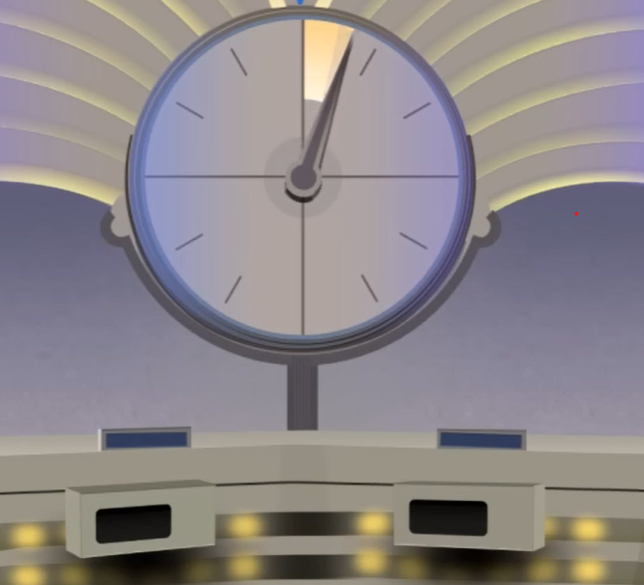
The Countdown Clock - YouTube

Slide 6
Key Stage 2..
1. Leg raisers | 9. Squat jumps | 17. Sit ups
2. Squats | 10. Exploding star jumps | 18. Hip circles
3. Jumping jacks | 11. Run on the spot | 19. Air bike
4. V sit | 12. Burpees | 20. Lunges
5. Arch (superman) | 13. Skaters | 21. Squat kicks
6. Front support | 14. Twist jump | 22. 3 side step shuffle
7. Side support | 15. Spotty dogs | 23. Reach up high, touch the floor
8. Ladder climbs | 16. Press ups | 24. Back support

