Slide 1
A presentation to parents and carers:
Supporting your child with alphabet skills
Stockport Learning Support Service

Slide 2
What is the alphabet?
The word alphabet comes from the first two words of the Greek alphabet ‘alpha’ and ‘beta’
The alphabet is the code and key to the English Language and it consists of twenty six letters - 5 vowels and 21 consonants.
The word vowel comes from the Latin word ‘vowis’ meaning ‘voice.’
The word consonant comes from the Latin word ‘consonare’ meaning sounding together.

Slide 3
Why do we teach alphabet skills?
The alphabet is one of the first things children learn.
Every letter in the alphabet represents a sound in the spoken language.
The knowledge and understanding of this relationship between letters and sounds are the foundations of learning to read.
When we blend the individual sounds c, a, t together we make the word cat.
We teach the alphabet to give us an opportunity to explicitly teach letter names. Letter names are important to learn as many words are not decodable eg. said. Letter sounds are not helpful for such words.

Slide 4
Why do we teach alphabet skills?
We also teach alphabet skills to focus on terms such as:
Vowels
consonants
digraphs (a sound that is represented by two letters, eg oa in boat.)
trigraphs (a sound that is represented by three letters, eg. igh in night
Vowel digraphs and split digraphs
upper and lower case letters
Syllabification
(Don’t worry – you don’t need to know these.)

Slide 5
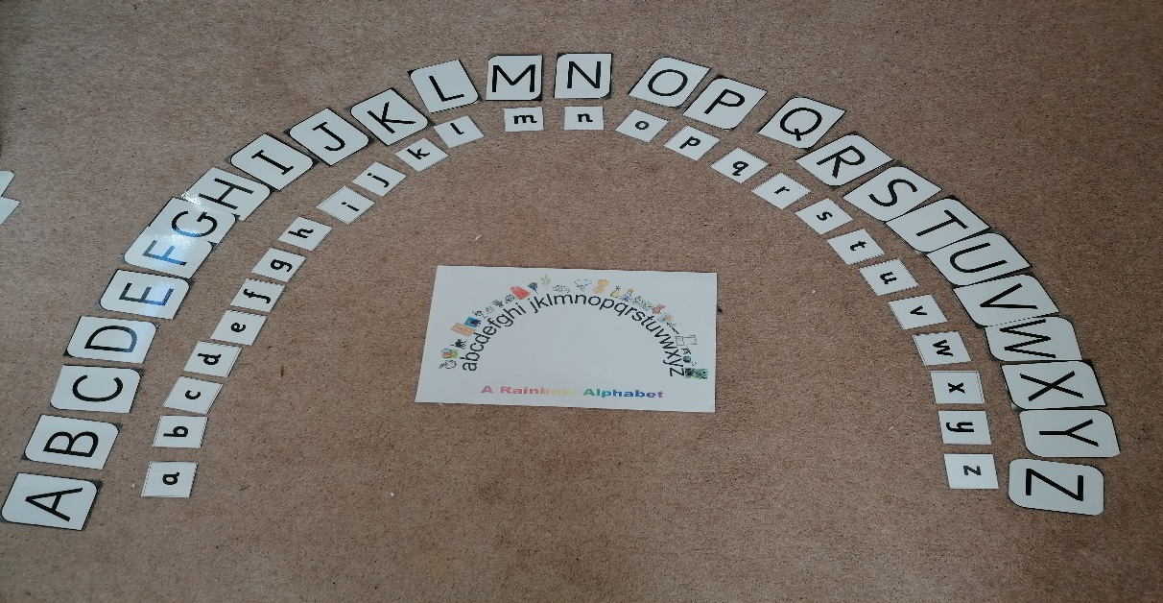
Why do we teach the alphabet in an arc?
Placing letters in an arc is easier for a child to see than in a straight line from left to right. The child is able to visualise this method even when the letters are removed.
Both upper case (or capitals) and lower case need to be learnt by name, sound and sequential order.

Slide 6
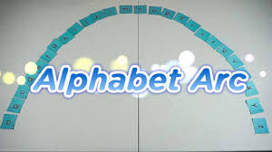
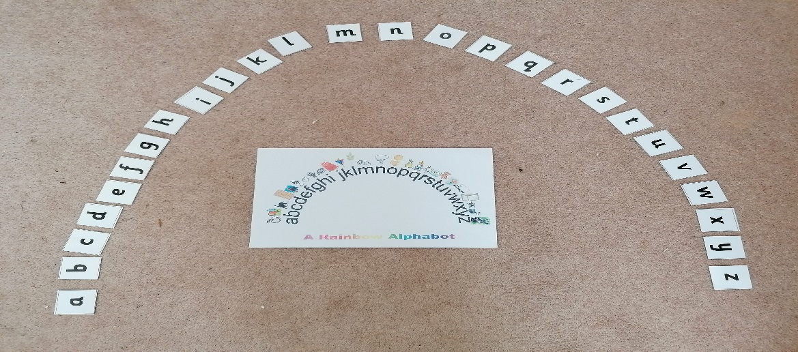
Making the alphabet
You don’t need to buy an alphabet resource! All you need is 26 blank cards. Write the alphabet names a-z. If possible, make an upper case set and a lower case set. Alternatively you could print your own out. Set them out in an arc like this.

Slide 7
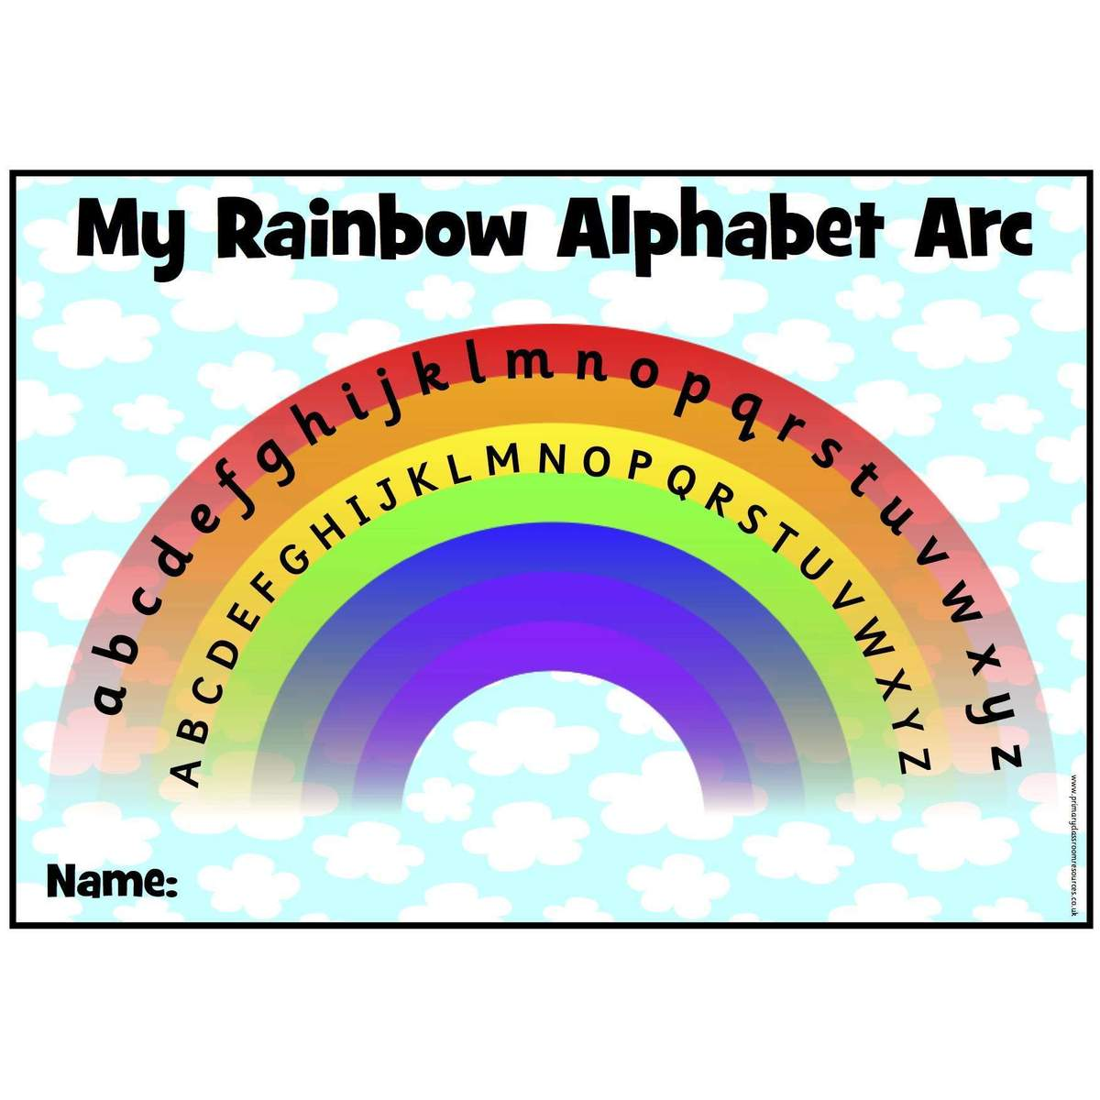
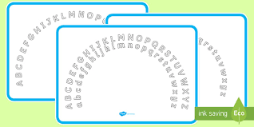
Alphabet visuals
You can also print out an alphabet arc. This makes a handy visual support.
Sparklebox, Twinkle and Pinterest are some sites where you can print off a ready made alphabet arc.

Slide 8
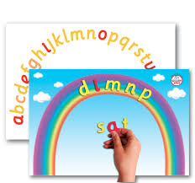
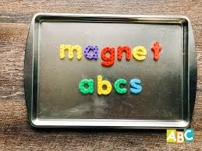
Other ways to make the alphabet
You may have a magnetic letters set that you can use to make an alphabet arc.
You may have a set of foam letters that you can use to make an alphabet arc.
You may have a set of wooden letters that you can use.

Slide 9
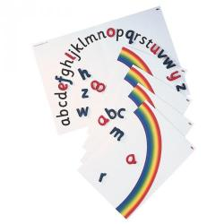
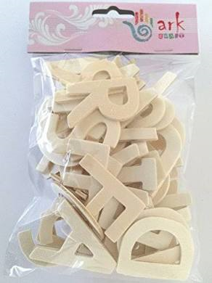
Commercial alphabet resources
If you did want to buy an alphabet resource, we recommend:
Rainbow alphabet arc Office stationary £6.88
Magnetic rainbow alphabet arc Smartkids £11.99 + VAT
Magnetic letters Smartkids from £5.99 + VAT
Plain wooden alphabet letters Amazon £4.99

Slide 10
How to create your alphabet arc
Locate letters A, M, N and Z (or lower case equivalents) and place them on the alphabet mat, floor or table. This sequence ensures the pupil recognises the beginning, middle and end of the alphabet.
Build up the letters in alphabetical order in the shape of a rainbow saying the correct letter name.

Slide 11
How to create your alphabet arc…
You can use an alphabet template to support, check and self-correct.

Slide 12
What to do next?
When all the letters are in the correct order your child can touch each letter as well as naming all the letter names in a sequence forwards from A – Z.
Depending on the alphabet knowledge of your child, they can then repeat the activity backwards from Z – A using the letter names.
Take note of how your child remembered how they identified certain letters, confused letters eg. b/d or didn’t know letters.
Your child can then build up knowledge and properties of the alphabet, eg. number of letters, consonants, vowels and alternative sounds such as short vowels (a in tap) and long vowels (a in tape.)

Slide 13
Helping your child to use a multi-sensory approach when learning the alphabet.
Using a multisensory teaching technique means learning through using more than one sense at a time. Using a VAK approach (visual, auditory and kinaesthetic) is very effective. This caters for all learning styles. An example could be touching each letter, looking at it and saying the letter name at the same time.

Slide 14
Alphabet activities
Alphabet sort:
Shuffle a set of alphabet letters (either wooden or printed cards) and ask your child to put them in order as quickly as possible. Use alphabet template to support.

Slide 15
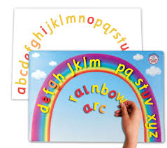
More alphabet activities
Letter thief!
Lay out a set of alphabet letters or cards in alphabetical order. While your child closes his or her eyes, take one letter away. Ask your child to open his/her eyes and identify the missing letter (a question mark ? card can be used to replace the missing letter). This game can be extended by removing more than one letter. Use alphabet template to support.

Slide 16
Alphabet games…
Match Up:
Hang a washing line with alphabet cards pegged to the line in order. Ask your child to name and match lower case letter to upper case letter.
Feely Bag: Place a selection of letters in a feely bag and ask your child to feel the letter shapes and then identify the letters by name.

Slide 17
More activities and ideas…
You or your child closes their eyes and points to certain letters
Take out a letter and guess which letter has been taken out
Clap every third letter name
Make common exception words and tricky words
Make digraphs (sound represented by two letters such as oa in boat)
Look at letter patterns
Play hangman
Make words using sound boxes with missing letter/sound, eg. circle
Match lower case with respective upper case letters

Slide 18
Useful Websites
www.sparklebox.co.uk
www.twinkl.co.uk
www.smartkids.co.uk
www.crossboweducation.com

Slide 19
Beyond the arc – what next?
You can now reinforce and extend all these alphabet ideas to support all areas of reading and writing. Have fun…
If you would like further information please contact the Learning Support Service

